Slide 1
API & Management

Slide 2
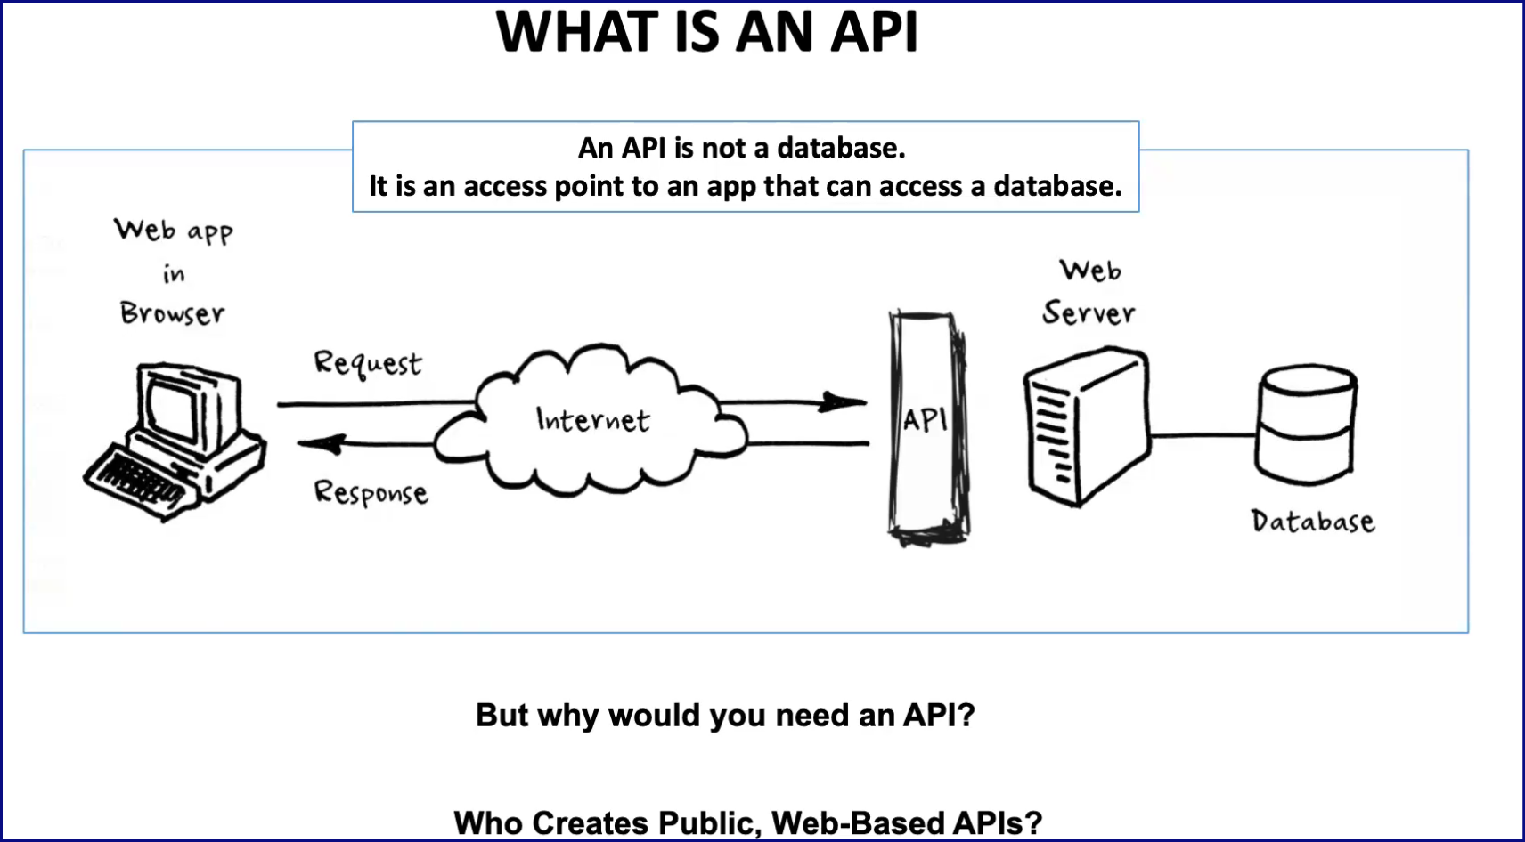


Slide 3
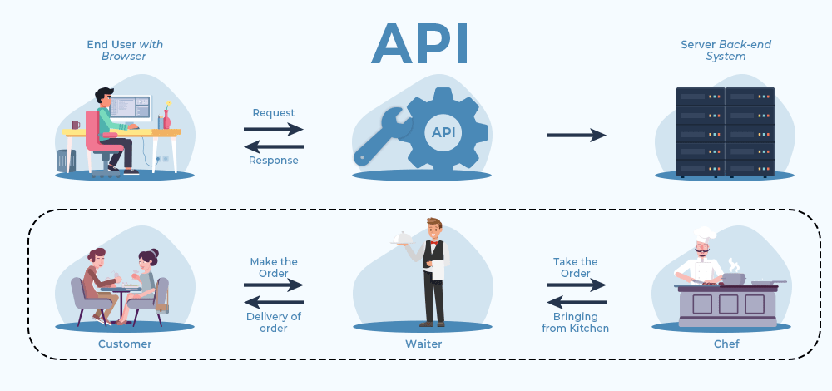
What is an API (Application Programming Interface)

Slide 4
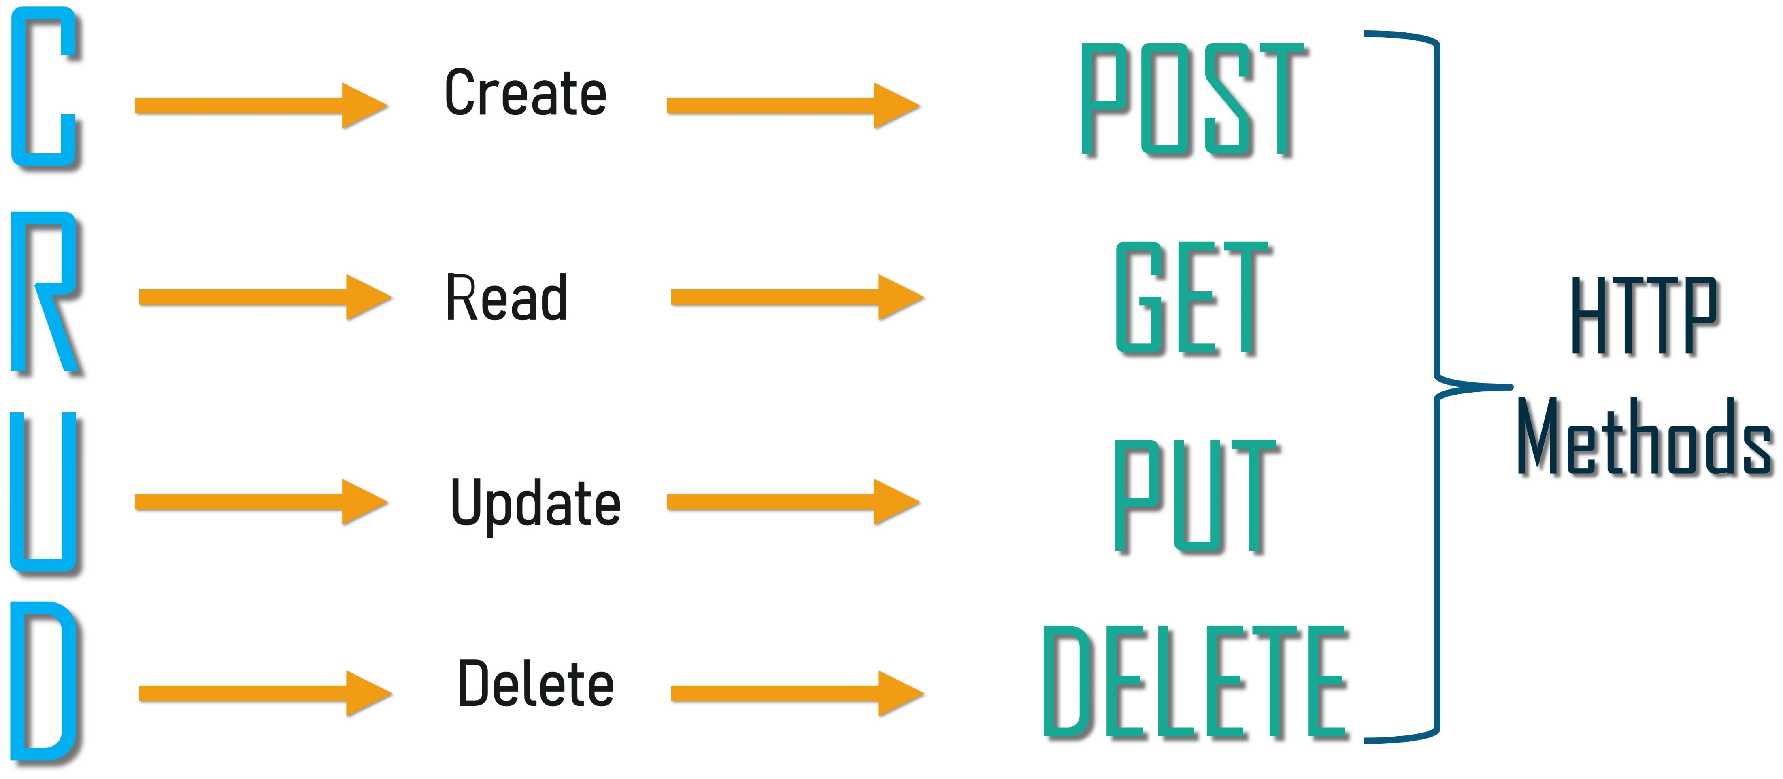
An API acts as an interface that allows proper communication between two programs whereas a web application is a network-based resource responsible for completing a single task. Also, it’s important to know that “All web services are APIs, but not all APIs are web”.
https://www.geeksforgeeks.org/what-is-an-api/

Slide 5
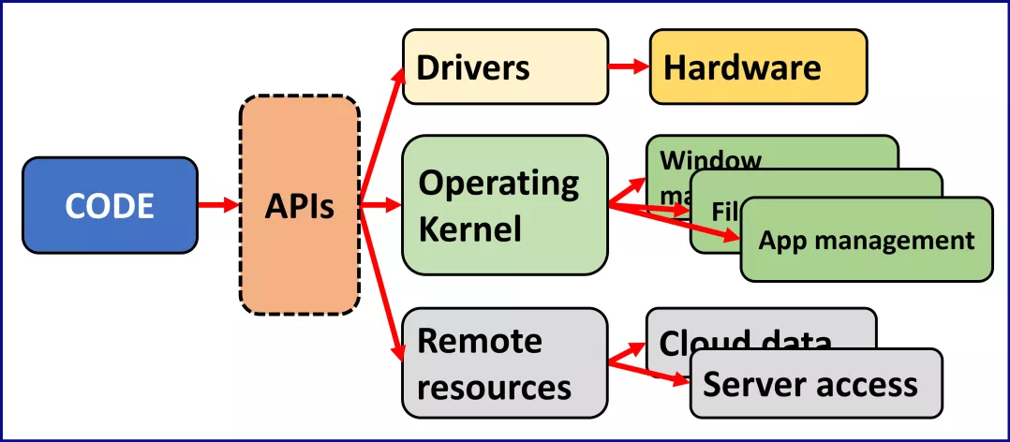
Essentially, the interface allows the computing elements to send information to each other; sometimes it's a one-way bridge (e.g. a mouse sending input signals to a laptop, using a USB socket), but they're more likely to be two-way.

Slide 6
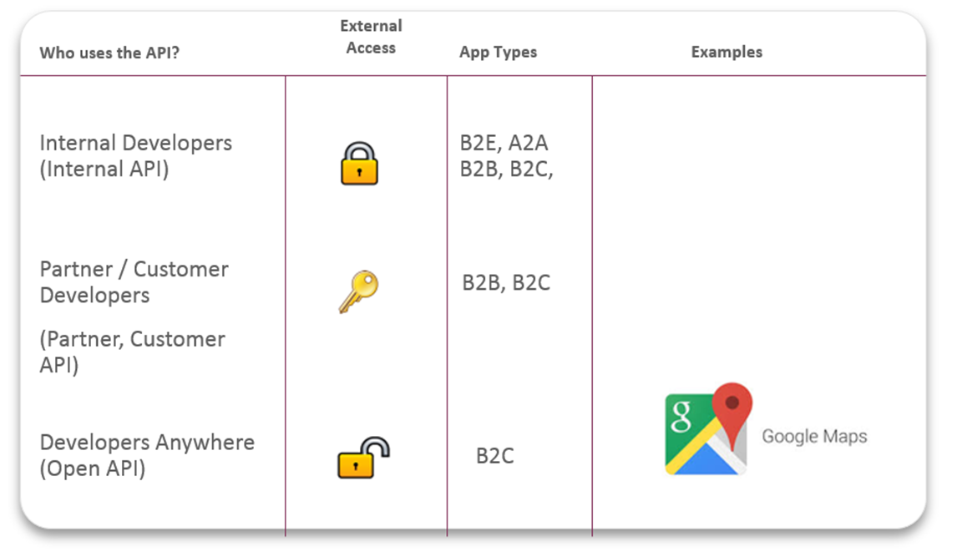
Types of APIs by audience

Slide 7

API Traffic Management
Azure API Management

Slide 8
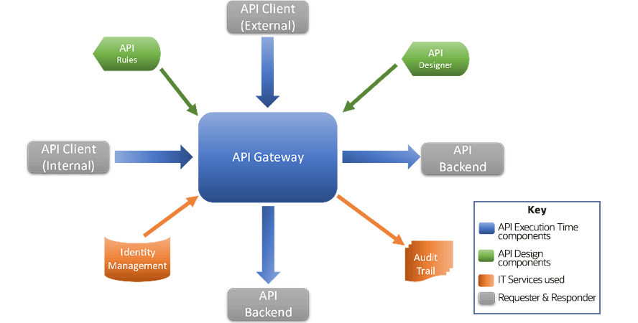
The gateway provides the visible URL for an API, applies rules (sometimes also called policies) to the use of that API, and then directs the API call to the back-end implementation. Typically, the gateway will be given both the API specification and details of the rules it should apply
https://www.oracle.com/cis/cloud/cloud-native/api-management/what-is-api/

Slide 9
API Gateway: A Deeper Technical Dive 1. Routing and Request Aggregation: API Gateways play a crucial role in handling requests by routing them to the appropriate microservices. For example, if you have separate services for user authentication, product information, and order management, the API Gateway will direct requests to these services based on the request path or other criteria. Furthermore, it can aggregate results from multiple services into a single response to streamline client-side processing. 2. Load Balancing and Service Discovery: In a microservices architecture, a single service might be running on multiple instances for load distribution and redundancy. An API Gateway often includes a load balancer to distribute incoming requests evenly across these instances. It also integrates with service discovery mechanisms to route requests to available service instances dynamically. 3. Security: API Gateways enhance security in several ways: - 𝗔𝘂𝘁𝗵𝗲𝗻𝘁𝗶𝗰𝗮𝘁𝗶𝗼𝗻 𝗮𝗻𝗱 𝗔𝘂𝘁𝗵𝗼𝗿𝗶𝘇𝗮𝘁𝗶𝗼𝗻: It can enforce authentication and authorization policies, ensuring that only valid and permitted requests reach backend services. - 𝗧𝗵𝗿𝗲𝗮𝘁 𝗣𝗿𝗼𝘁𝗲𝗰𝘁𝗶𝗼𝗻: It acts as a shield against common security threats such as SQL injection, cross-site scripting (XSS), and others by validating request formats and payloads. - 𝗥𝗮𝘁𝗲 𝗟𝗶𝗺𝗶𝘁𝗶𝗻𝗴 𝗮𝗻𝗱 𝗤𝘂𝗼𝘁𝗮𝘀: To protect backend services from being overwhelmed by too many requests, the API Gateway can impose rate limits and quotas on clients. 4. API Transformation and Orchestration: API Gateways can transform requests and responses to and from backend services. This includes transforming protocols (e.g., from HTTP to WebSocket), rewriting request paths, or converting data formats. It can also orchestrate complex service interactions, making it easier to implement composite services or workflows. 5. Monitoring and Analytics: As the entry point for all service requests, API Gateways are in a prime position to monitor traffic and gather data. They can track metrics such as request count, response times, and error rates, providing valuable insights for performance optimization and capacity planning. 6. Caching: To reduce the load on backend services and improve response times, API Gateways can cache responses. For instance, data that doesn’t change frequently (like product descriptions in a catalog) can be cached at the gateway level. 7. Version Management and Canary Releases: API Gateways facilitate API versioning, allowing clients to use different versions of an API simultaneously. They also support canary releases (gradual rollouts of new features), directing a subset of traffic to new service versions for testing purposes.

Slide 10
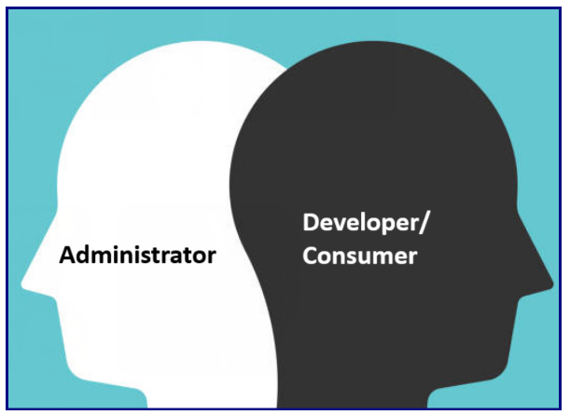
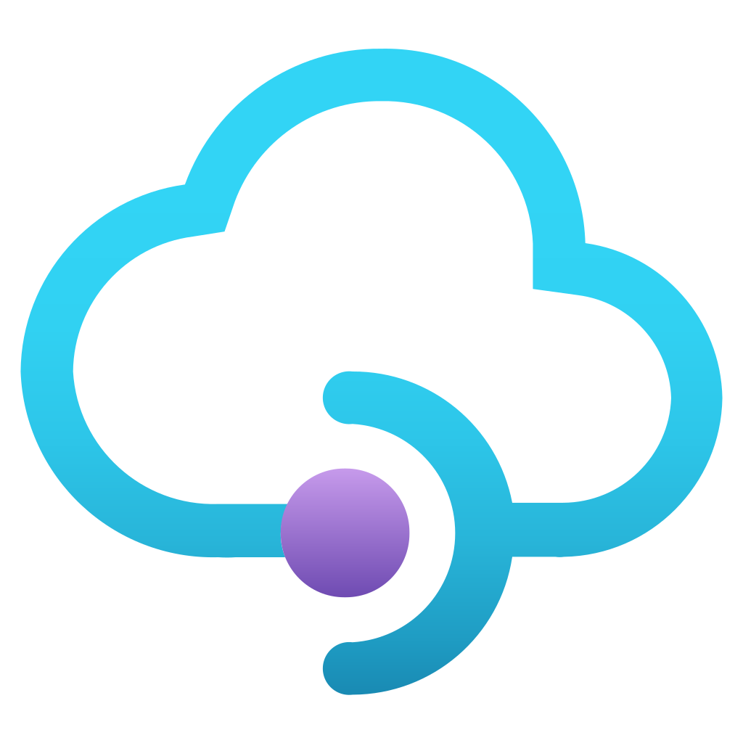
Azure API Management
https://learn.microsoft.com/en-us/azure/api-management/api-management-key-concepts

Slide 11
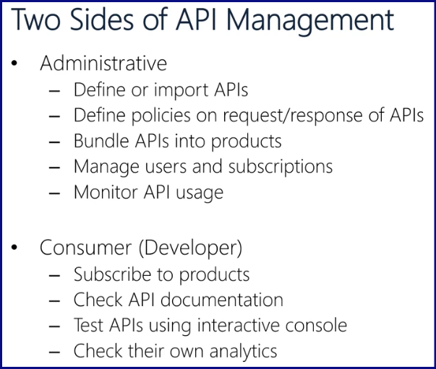

Slide 12
https://blog.bytebytego.com/p/ep122-api-gateway-101

Slide 13
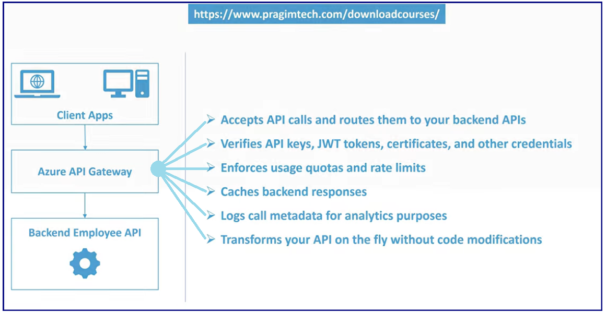
API Gateway Flow

Slide 14
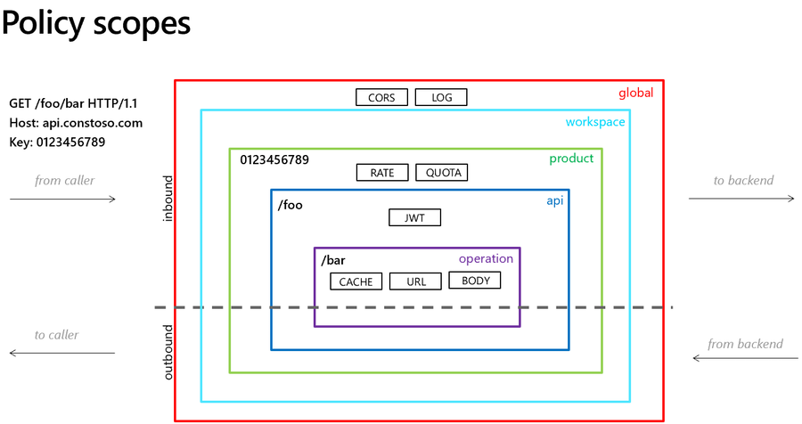

Slide 15
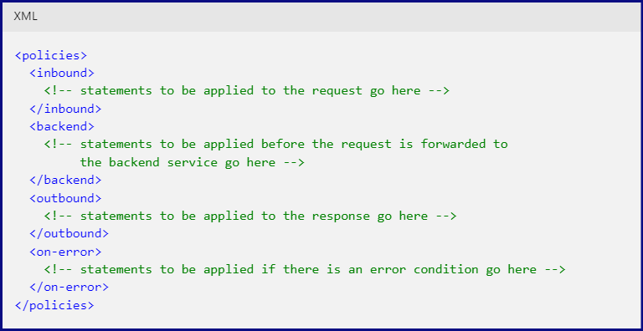
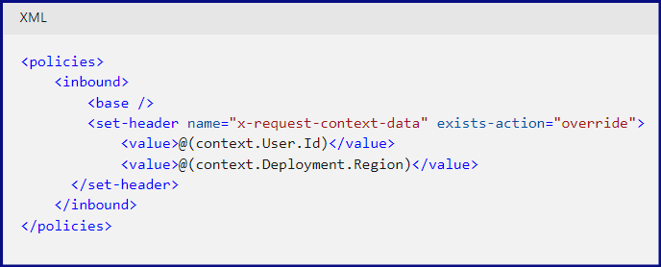
https://learn.microsoft.com/en-us/azure/api-management/api-management-policies

Slide 16
APIs have become the backbone of modern software development, enabling seamless integration and communication between different systems. The infographic covers several crucial areas: 1. Introduction to APIs: Defining APIs and outlining different types like public, private, partner, and composite APIs. 2. API Architectures: Highlighting popular architectures including REST, GraphQL, SOAP, gRPC, and others. 3. API Documentation: Showcasing tools like Swagger, Postman, and OpenAPI Specification that help create clear, user-friendly documentation. 4. API Testing: Featuring various testing tools such as Postman, SoapUI, and JMeter to ensure API reliability and performance. 5. API Security: Emphasizing important security measures like authentication, authorization, rate limiting, and encryption. 6. API Management: Exploring API gateways, lifecycle management, and analytics tools for effective API oversight. 7. Implementation Frameworks: Listing popular frameworks like Flask, Spring Boot, and Express for building APIs. 8. API Design Best Practices: Touching on key principles such as RESTful conventions, versioning, and pagination.

Slide 17
SOAP (Simple Object Access Protocol): SOAP is a protocol-based, heavyweight standard for structured information exchange. It relies on XML messages and can operate over various lower-level protocols like HTTP, SMTP, and more. Known for its strict standards, security features, and reliability.
RESTful (Representational State Transfer): REST is an architectural style based on the principles of simplicity, statelessness, and resource-based interactions. It typically uses standard HTTP methods (GET, POST, PUT, DELETE) for communication. RESTful APIs are lightweight and suitable for web and mobile applications.
gRPC: gRPC is a high-performance, language-agnostic framework for building efficient, real-time APIs. It uses Protocol Buffers for serialization and offers features like authentication, load balancing, and bidirectional streaming. Ideal for microservices and real-time applications.

Slide 19
https://www.linkedin.com/search/results/content/?keywords=api%20gif&origin=GLOBAL_SEARCH_HEADER&sid=%3Ae~

Slide 20
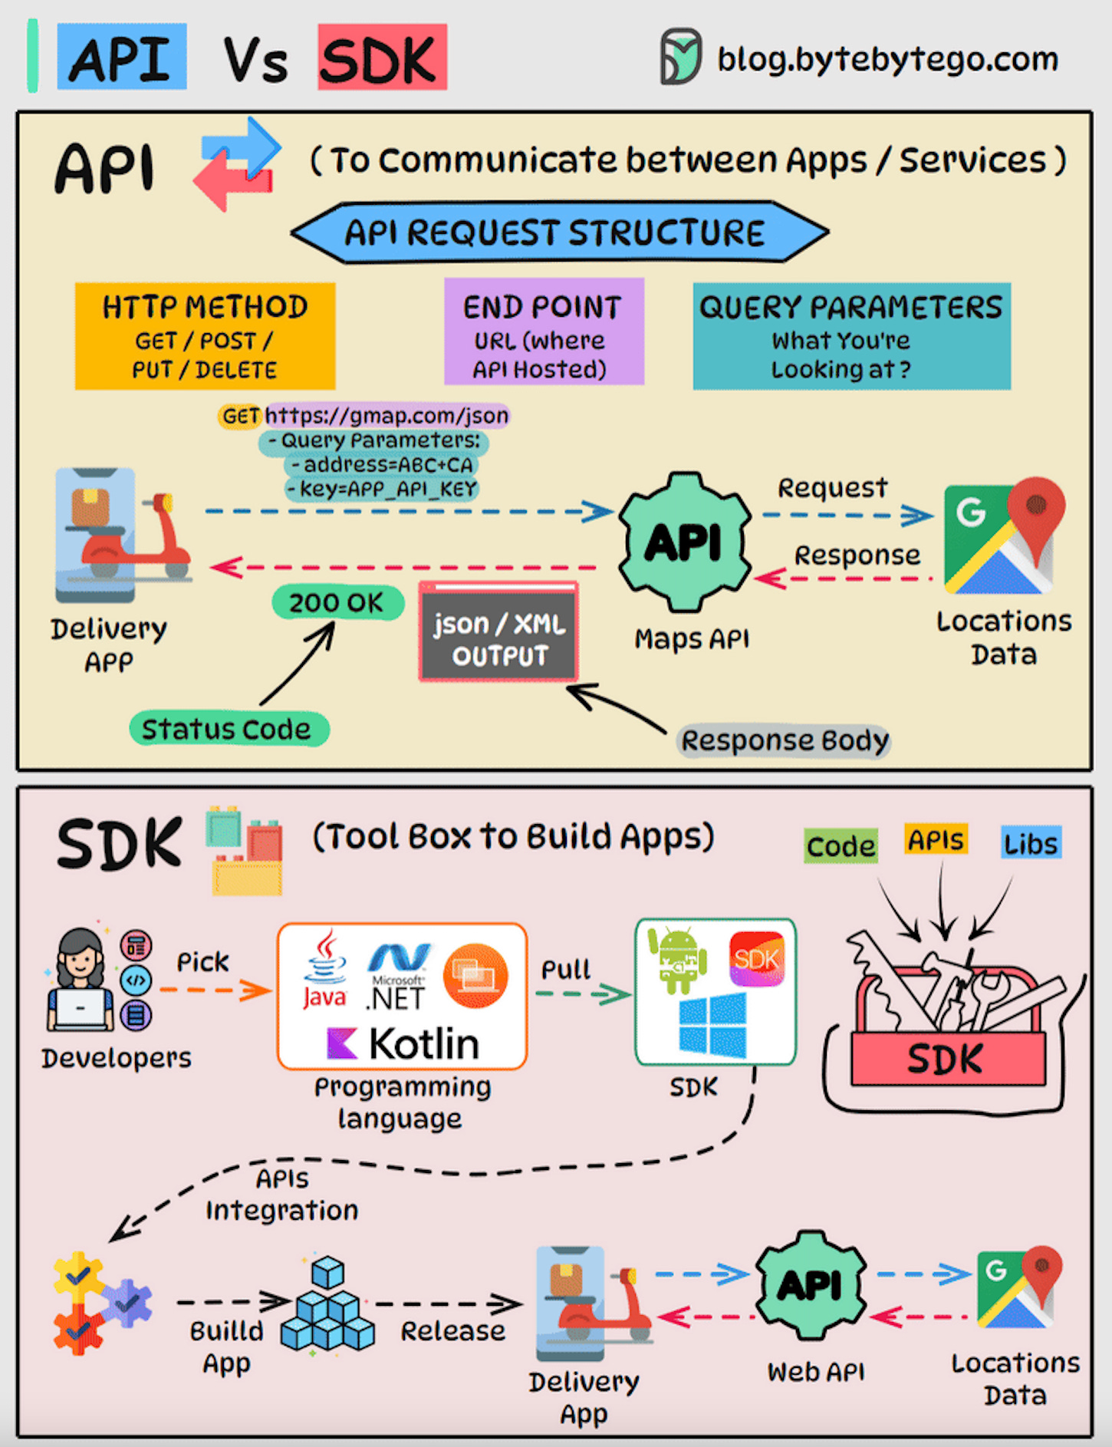
API (Application Programming Interface) and SDK (Software Development Kit) are essential tools in the software development world, but they serve distinct purposes: API: An API is a set of rules and protocols that allows different software applications and services to communicate with each other.
It defines how software components should interact.
Facilitates data exchange and functionality access between software components.
Typically consists of endpoints, requests, and responses.
SDK: An SDK is a comprehensive package of tools, libraries, sample code, and documentation that assists developers in building applications for a particular platform, framework, or hardware.
Offers higher-level abstractions, simplifying development for a specific platform.
Tailored to specific platforms or frameworks, ensuring compatibility and optimal performance on that platform.
Offer access to advanced features and capabilities specific to the platform, which might be otherwise challenging to implement from scratch.
The choice between APIs and SDKs depends on the development goals and requirements of the project.

Slide 21
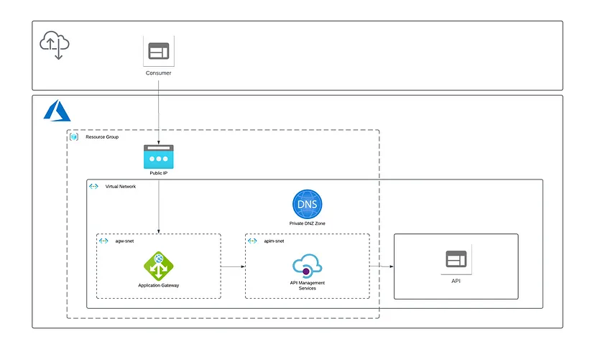
Securing External APIs with Azure Application Gateway and Azure API Management
https://keithjenneke.medium.com/securing-external-apis-with-azure-application-gateway-and-azure-api-management-beda796b3ef1

Slide 22
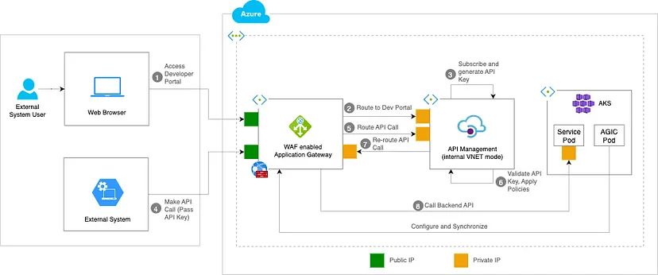
Azure App Gateway, API Management and AKS Integration — Design Pattern 1
https://medium.com/@khandelwal.praful/azure-app-gateway-api-management-and-aks-integration-a746e6d122d9

Slide 23
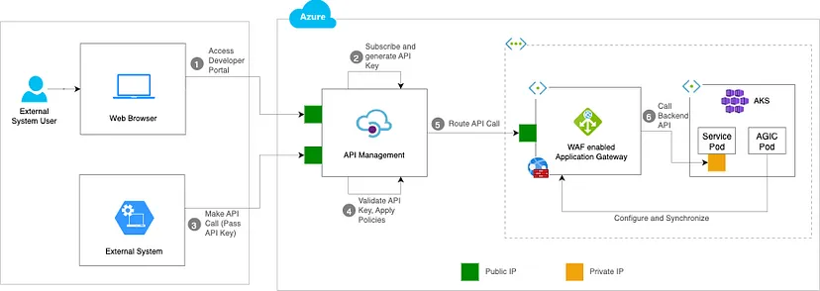
Azure App Gateway, API Management and AKS Integration — Design Pattern 2
https://medium.com/@khandelwal.praful/azure-app-gateway-api-management-and-aks-integration-design-pattern-2-77bc84690745

Slide 24
API Knowledge Source?
https://learn.microsoft.com/en-us/answers/questions/1065016/difference-between-application-gateway-and-api-man
https://www.youtube.com/watch?v=6DLZdw5nDHo
Rapid API (Google it)
Swagger
https://azure.github.io/api-management-resources/
https://techcommunity.microsoft.com/t5/azure-architecture-blog/leverage-azure-api-management-to-distribute-api-traffic-to/ba-p/4041813

Slide 25
https://betterprogramming.pub/how-to-auto-generate-an-api-gateway-for-azure-kubernetes-services-f20149253ed3

